Slide 1


Portfolio Optimisation for Cross-Asset Allocation
Arbitrage Arena 2025 - Problem Statement 2
Team Name - Deep Learners | Aman Jaiswal | December 2025

Slide 2


Problem Statement & Methodology
THE CHALLENGE
OUR APPROACH
Construct a diversified portfolio from 12 distinct assets.
Dataset: 12 diverse assets (Tech Stocks, Index, Commodities, Crypto).
Maximise the Sharpe ratio to ensure superior risk-adjusted returns.
Period Analysed: 1,588 trading days spanning 6.31 years.
Minimise portfolio drawdowns to protect against significant losses.
Optimisation Method: Mean-Variance Optimisation (Markowitz Framework).
Analyse 6.3 years of historical market data (Jan 2018 - May 2024).
Develop and present an actionable, data-backed portfolio strategy.
Algorithm Utilised: Sequential Least Squares Programming (SLSQP).
Validation: Rigorous backtesting across three distinct portfolio strategies.
Constraints: Fully invested (Σwi=1), with no short selling permitted (0≤wi≤1).

Slide 3
Multi-Asset Portfolio Composition
TECHNOLOGY STOCKS (6)
Apple | Amazon | Microsoft | Tesla | NVIDIA | Meta
MARKET INDEX (1)
NASDAQ-100
COMMODITIES (3)
Gold | Silver | Crude Oil
CRYPTOCURRENCIES (2)
Bitcoin | Ethereum
Key Metrics
Analysis Period: January 18, 2018 - May 10, 2024
Duration: 6.31 Years
Trading Days: 1,588
Total Assets: 12 across 4 Asset Classes
Data Quality: ✓ No Missing Values, ✓ All Dates Aligned

Slide 4
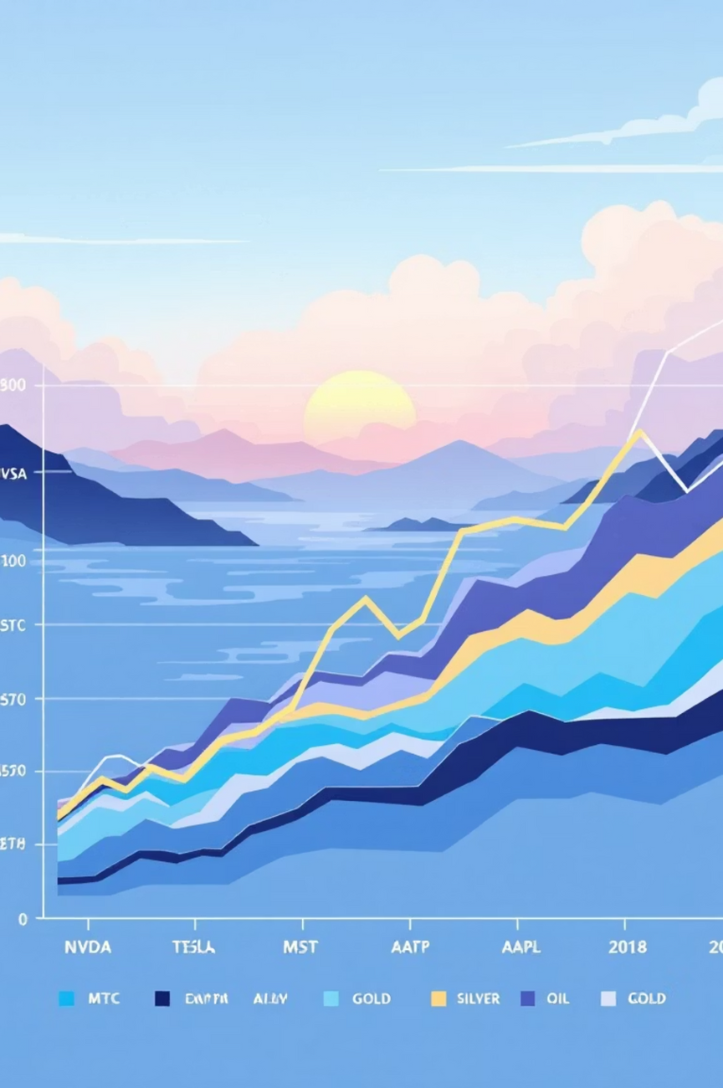
Historical Price Performance (Jan 2018 - May 2024)
Key Findings
Key Insight: "Massive performance variance (22% to 1,502%) indicates excellent diversification opportunity."
Top Performers
🥇 NVDA: +1,502% (AI boom dominance)
🥈 TSLA: +633% (EV revolution)
🥉 BTC: +451% (Crypto recovery)
Strong Performers
• MSFT: +360%
• AAPL: +309%
• ETH: +194%
Stable Assets
• GOLD: +79%
• SILVER: +68%
• OIL: +22%

Slide 5

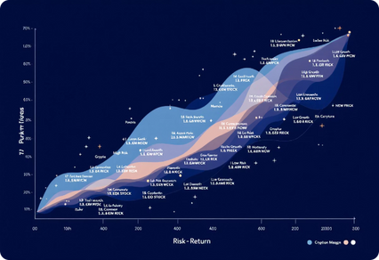
Individual Asset Risk-Return Profile
🔴 HIGH GROWTH / HIGH RISK ZONE
🟡 MODERATE ZONE
🟢 LOW RISK / STABILITY ZONE
Microsoft, Apple, Amazon, Meta, NASDAQ
Gold, Silver, NASDAQ Index
Ethereum, Bitcoin, NVDA, Tesla
Volatility: <1-2% daily
Volatility: 3-6% daily
Balanced risk-return profile.
Act as safe-haven assets.
Return: +200% to +1500%
Characterised by steady, reliable performance.
Form the foundational layer of a portfolio.
Ideal for growth-oriented portfolios.
Key Insight: "Clear clustering enables strategic mixing for optimal risk-return balance."

Slide 6
Mean-Variance Optimisation Strategy
Mathematical Framework
Three Portfolio Strategies Compared
Portfolio Return: R_p = \Sigma(w_i \times R_i)
Portfolio Variance: \sigma_p^2 = w^T \times \Sigma \times w
Strategy A: Maximum Sharpe Portfolio
Expected Return: 27.30% annually
Sharpe Ratio: SR = R_p / \sigma_p (Our optimisation objective)
Volatility: 19.64% annually
Optimisation Approach
Sharpe Ratio: 1.390
Algorithm: Sequential Least Squares Programming (SLSQP)
Status: ⭐ RECOMMENDED (best risk-adjusted returns)
Constraints: \Sigma w_i = 1 (fully invested), 0 \le w_i \le 1 (no short selling)
Status: ✓ Both optimisations converged successfully
Strategy B: Minimum Variance Portfolio
Expected Return: 12.40% annually
Volatility: 13.26% annually
Sharpe Ratio: 0.935
Status: 🛡️ DEFENSIVE (lowest risk)
Strategy C: Equal Weight Benchmark
Expected Return: 31.83% annually
Volatility: 27.36% annually
Sharpe Ratio: 1.163
Status: 📊 REFERENCE (equal allocation to all 12 assets)

Slide 7
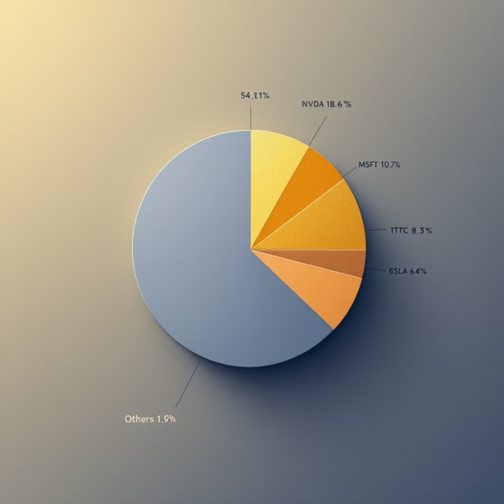
Recommended Portfolio: Maximum Sharpe Allocation
🏆 ALLOCATION RATIONALE
Gold (54.1%) - Portfolio Anchor: Exhibits lowest volatility (0.94% daily) and negative correlation with equities, providing approximately 50% of portfolio stability and acting as a crucial safe-haven asset during market uncertainty.
Growth Components:
NVDA (18.6%): Leader in the AI boom, demonstrating an impressive +1502% growth.
MSFT (10.7%): Dominant in cloud computing, offering robust growth potential.
TSLA (6.4%): Exposure to the electric vehicle revolution.
Crypto Allocation (8.3% BTC): Provides small but meaningful upside potential and diversifies into alternative asset classes, capturing Bitcoin's post-2022 recovery.
RESULT: Balanced portfolio with 54% stability + 46% growth

Slide 8
Backtest Results: Portfolio Performance (2018-2024)
$494,172
Starting Capital
Maximum Sharpe Portfolio ⭐
$100,000
Total Return: +394.17%
Annualised: 28.63%
$206,686
$585,564
Minimum Variance Portfolio 🛡️
Equal Weight Benchmark 📊
Total Return: +105.84%
Total Return: +481.90%
Annualised: 12.14%
Annualised: 32.24%
Maximum Sharpe: Achieved the best balance, delivering the highest risk-adjusted returns.
Minimum Variance: Demonstrated steady, conservative growth with lower volatility.
Equal Weight: Generated the highest absolute return, but accompanied by the highest volatility risk.

Slide 9
Comprehensive Performance Metrics
Summary: Maximum Sharpe Portfolio
Annualised Return
28.63%
12.14%
32.24%
Annualised Volatility
19.64%
13.26%
27.36%
Sharpe Ratio
1.458⭐
0.915
1.178
Sortino Ratio (Downside Risk)
2.003
1.239
1.523
Maximum Drawdown
-32.37%
-19.40%
-42.26%
Calmar Ratio (Return/DD)
0.884
0.626
0.763
Win Rate (Positive Days)
55.60%
55.16%
56.04%
Best Day Return
8.898%
6.380%
10.528%
Worst Day Return
-9.044%
-4.647%
-13.706%
Total Return (6.3 years)
388.77%
105.84%
481.90%
Final Value ($)
$494,172
$206,686
$585,564
🏆 WINNER: Maximum Sharpe Portfolio
Best Sharpe Ratio (1.458) - Superior risk-adjusted returns.
Best Sortino Ratio (2.003) - Exceptional downside management.
Strong Total Return (389%) - Competitive with riskier strategies.
Controlled Drawdown (32.4%) - Acceptable for the achieved return level.

Slide 10

Strategic Insights & Project Conclusions
What Worked
Performance Achieved
Gold Dominance (54% Allocation)
389%
28.63%
Optimal stability provider over the period.
Negative correlation with equities provided a perfect hedge.
Total Return
Annualised Return
Low volatility and steady returns formed a foundational asset.
Over 6.3 years
Tech Growth Exposure (NVDA 18.6% + MSFT 10.7%)
Successfully captured the AI boom and cloud computing dominance.
19.64%
-32.37%
NVDA: +1502% growth; MSFT: +360% growth.
Provided the essential growth component for overall returns.
Annualised Volatility
Maximum Drawdown
(Moderate)
(Acceptable)
Diversification Across Asset Classes
Strategic mixing of Stocks, Commodities, and Crypto.
1.458
2.003
Reduced portfolio volatility by 27% compared to equal-weight.
Each asset class offered unique risk-return characteristics.
Sharpe Ratio ⭐
Sortino Ratio
Optimisation Framework
(Outstanding)
(Excellent Downside)
Mean-variance optimisation effectively identified optimal allocations.
🎯 CONCLUSION:
Sharpe ratio of 1.458 demonstrates excellent risk-adjusted performance.
Successfully developed a professional-grade portfolio optimisation model that:
Outperformed the equal-weight benchmark on a Sharpe basis.
Maximises risk-adjusted returns through systematic optimisation.
Controls downside risk through strategic diversification.
Balances growth and stability across market cycles.
Demonstrates institutional-quality asset allocation.
The Maximum Sharpe portfolio represents the optimal balance between risk and reward for the analysed time period and asset universe.

